Slide 1
Voucher Programmes:
Lessons from a review of voucher programmes in Low Income Countries
Anna Gorter
Corinne Grainger
Interagency Working Group on Result Based Financing
15 November 2011, DFID´s offices, London

Slide 2
Outline of presentation
Short introduction to vouchers
Major changes with traditional approaches
The evidence base so far
Preliminary results of our on-going review
  What we are reviewing
  Some early findings
Discussion points

Slide 3
Input- and results-based financing approaches
Govt / donor funding
Govt / donor funding
Govt / donor funding
Govt / donor funding
Govt / donor funding
Govt / donor funding
Govt / donor funding
Govt / donor funding
Govt / donor funding
Govt / donor funding
Govt / donor funding
Govt / donor funding
Management Agency
(Govt / Non-Govt
HEF cards /
Insurance cards / vouchers / conditional cash transfers
Management Agency
(Govt / Non-Govt
Management Agency
(Govt / Non-Govt
Management Agency
(Govt / Non-Govt
$
$
$
$
$
$
$
$
HEF cards
Insurance cards Vouchers
HEF cards
Insurance cards Vouchers
HEF cards
Insurance cards Vouchers
Inputs
(i.e. salaries, equipment,
materials)
Inputs
(i.e. salaries, equipment,
materials)
Inputs
(i.e. salaries, equipment,
materials)
Inputs
(i.e. salaries, equipment,
materials)
Performance based contracting (quality, no. of clients, etc)
Performance based contracting (quality, no. of clients, etc)
Performance based contracting (quality, no. of clients, etc)
Performance based contracting (quality, no. of clients, etc)
Claim
(vouchers)
Contract
($)
Contract
($)
Contract
($)
Contract
$
Claim
Claim
Claim
Health Facilities
Health Facilities
Health Facilities
Health Facilities
Health Facilities
Health Facilities
Health Facilities
Health Facilities
Health Facilities
Health Facilities
Health Facilities
Services / $
Services / $
Services / $
Health Facilities
Services / $
Clients
Clients
Clients
Clients
Entitlement
(cards / vouchers)
Entitlement
(card / voucher)
Entitlement
(card / voucher)
Entitlement
(card / voucher)
Output-based
Output-based
Output-based
Input-based Approach
Output-based
Input-based Approach
Input-based Approach
Input-based Approach
Supply side
OBA
Supply side
OBA
Supply side
OBA
Supply side
RBF
Demand side OBA
Demand side OBA
Demand side OBA
Demand side RBF

Slide 4
Results Based Financing approaches
RBF (OBA, P4P) | Examples | Incentives
 |  | Provider | Client
Supply-side | Performance based contracting | X | (x)
Demand-side | Conditional cash transfers |  | X
 | Health insurance | X | X
 | Vouchers | X | XX

Slide 5

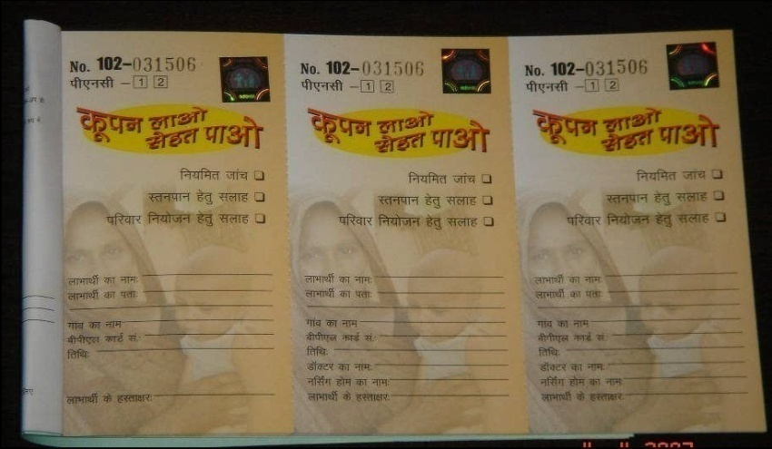

Some examples of vouchers
Voucher from Pakistan
Voucher from India (above) and Nicaragua (below)

Slide 6
Major changes with traditional input-based approaches
For the client…
Removes uncertainty of unknown treatment costs (clients consider it as an assurance)
Moves power to the client
Can address other barriers of access to care:
  Subsidising transport, food and other costs
  Providing guidance and improved information
Opportunity to target subsidies to the poor (Kenya-food, Bangladesh-CCT)
Increased quality of services

Slide 7
Major changes cont….
Changes that concern providers…
In principle any provider can join – public, private or FBO/NGO – if sufficiently good quality
Private providers open their doors to QA visits, use of treatment protocols, reporting requirements, etc.
Can introduce competition & incentives
Providers need to offer good (quality) services to attract clients
Can stimulate service provision in rural areas (particularly combined with cash for transport)

Slide 8
The evidence so far
Bellows et al. (2010) – systematic review of 15 evaluation studies of 7 SRH voucher programmes:
Increased utilisation of services
  Bangladesh and Cambodia: increase in facility-based deliveries
Improved quality of care
  Nicaragua, higher user satisfaction among adolescent voucher users than controls, some aspects of service quality improved over time
Improved population health outcomes
  Uganda: 57% reduction in syphilis prevalence among general population within 10 km
  Nicaragua: reduction in STI prevalence among sex workers
  Taiwan: lower fertility rates

Slide 9
Meyer et al. (2011) – systematic review of 24 studies evaluating 16 different VPs:
Modest evidence that VPs effectively target specific populations for health goods/services (based on 4 VPs)
Robust evidence that VPs increase utilisation (13VPs)
Modest evidence that VPs improve the quality (3VPs)
Insufficient evidence to determine efficiency of VPs (only 1 VP)
VPs do not have an impact on health (6 VPs); however, small changes in the evidence could change conclusion
Need for further rigorous evaluations to
strengthen evidence base

Slide 10
Review Paper looking at structural & implementation issues
Identification of the Voucher Programmes
  VPs identified through earlier reviews
  Literature search
  Information from key contacts
Inclusion of:
  VPs without physical vouchers
Exclusion of:
  Vouchers for goods or only transport
  Vouchers as marketing or referral/research tools
  Programmes starting after March 2011

Slide 11
13 countries identified which implemented or are implementing 36 voucher programmes
Regions | # | Countries
Africa | 5 | Kenya (2), Uganda (2), Sierra Leone
Latin America | 3 | Nicaragua (3)
Central Asia | 1 | Armenia
South Asia | 17 | Bangladesh (4) India (10) Pakistan (3)
East Asia and the Pacific | 10 | Cambodia (5), China (2), Indonesia, Korea, Taiwan

Slide 12
Increasing number of VPs
Started post March ’11 or is planned
Just to give you an idea…
  Asia: Pakistan (PSI), Laos (WHO, LuxDev), Vietnam (MSI)
  Africa: Tanzania (KfW), Cameroun (KfW), Yemen (KfW, on hold),
  Fast growing number of Social Franchising programmes which have or are planning to introduce vouchers (MSI & PSI)

Slide 13
Overview of 36 VPs cont….
Characteristic | # | Observation
Initiated after 2000 | 26 | Oldest started in 1960s (Taiwan, Korea)
Initiated/financed by:
Donor | 14 | Donors are: KfW, USAID, BTC, World Bank (1), DfID, Dutch Govt, Gates, NGOs
Government | 7 | Armenia, Bangladesh (with donors), India (3), Korea, Taiwan
NGO (12), Research (2), UNFPA (1) | 15 | Social Franchise NGO (6), Pop Council (2), local NGOs (4)
Large VPs (> 1 million US$/year) | 8 | 4 initiated by Govt, 1 Govt/donors, and 3 by KfW (6 are still active)

Slide 14
Overview of 36 VPs cont…
Active or Not? | # | Observation
Still active | 12 | 4 initiated by Govt, 3 by KfW, 4 by Social Franchise, 1 by USAID. 6 of 12 are large VPs
Not active anymore | 24
Met objectives | 3 | Taiwan, Korea, Indonesia
Small pilots or studies | 13 | 6 taken over by or informed other VPs (Bangladesh, Cambodia, Pakistan), 7 pure pilots (6 in India, 1 Uganda)
Taken over by other interventions | 3 | China: investment in primary health services (payment per capita), Nicaragua (1)
No funding | 5 | All initiated by NGOs before 2000: Nicaragua (2), India (2), Kenya (1)
Notes:
Size-wise there tend to be either large programmes initiated by government or donor or small pilots or research studies –
12 VPs are still active: 4 initiated by governments: Armenia, 2 in India and 1 in Bangladesh (in collaboration with donors). 3 KfW: Uganda, Kenya, Cambodia. 4 by social Franchise (3 MSI, 1 PSI) and 1 by USAID in Cambodia. Six of these 12 are large programs
24 are not active anymore. Three because they met their objectives: fertility at replacement levels in Taiwan and Korea and in Indonesia private midwifes available in rural areas.
Thirteen were pilots, or small studies which pilots either tend to end (end of research) or be scaled up
Pilots, 7 pure pilots: 6 India (5 USAID and 1 Government in India( and the University scheme in Uganda)

Slide 15
Rationale & Objectives
To accelerate the use of priority services (e.g. FP, STIs, abortion) and/or
To target and reach underserved and marginalised populations with priority services (e.g. India, Cambodia, Nicaragua) and/or
To provide priority services through contracting of private sector (e.g. Gujarat, Delhi, Armenia, Indonesia, Taiwan, Korea) and/or
To introduce social health insurance skills into the health financing arena (e.g. KfW-funded VPs in Kenya, Cambodia, Uganda) and/or

Slide 16
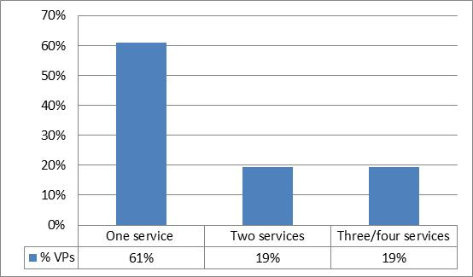
Number of Services Provided through the Voucher

Slide 17
What do we use vouchers for?
All 36 VPs provide(d) SRH services:
  SM services: 25 of the 36 VPs identified (69%)
  FP: 20 of the 36 (56%)
  RTIs/STIs: 9 of the 36 (25%)
3 VPs provide child health services (Armenia, India -Kolkata, China)
Other: abortion (Cambodia), cervical cancer screening (Nicaragua), GBV (Kenya)
Roughly one third pay or paid transport costs (mostly in Asia)

Slide 18
Analysis of a sub-sample of VPs
The following slides will present some preliminary results of an analysis of a sub- sample of 20 VPs for which we could find detailed information
The sub-sample is largely comparable with the overall sample of 36 voucher programmes

Slide 19
Key Structural Features (Management)
  Voucher Management Agency (VMA):
    7 by the Government within existing govt structures
    13 by private org (2 for profit, 11 non-profit)
Little competition:
  In 2 competitive tender for VMA (Cambodia, Kenya)
  In none was VMA changed: risk of monopolies
  The type of VMA is key (e.g. PwC versus MSI)

Slide 20
Type of Provider working in VPs
Type of Provider | # | Comments
All 3 sectors (Public, PFP, PNFP) | 9 | Bangladesh, Cambodia, Kenya, Pakistan, Nicaragua, Uganda
2 sectors (PFP & some public) | 3 | Armenia, Korea, Taiwan (mostly private)
2 sectors (PFP & PNFP) | 3 | Pakistan, Sierra Leone, Uganda
Single sector (PFP) | 4 | India, Pakistan
Single sector (public) | 1 | Cambodia

Slide 21
Key Structural Features (pricing/targeting)
In 12 out of 20 the voucher is free of charge
In 8 very low charges (MSI, Greenstar, KfW)
In most VPs the services are free at the point of service
16 out of 20 target the poor in some form
Evidence beginning to emerge that vouchers can and do target the poor and enhance equity (Bangladesh, China, Nicaragua, Pakistan)

Slide 22
Changes over time
Scaling up has taken various forms:
Pilot to full programme (Cambodia, Pakistan, India)
Extending geographically (Kenya, Cambodia, Pakistan Greenstar)
Widening range of services (Armenia, Cambodia, Uganda)
All VPs that have been started since 2000 and which were not pilots have continued & scaled-up

Slide 23
Lessons: vouchers in combination
Vouchers should not always be seen in isolation, they work well in combination with other approaches:
  Input-based approaches: vouchers plus quality improvement (e.g. training, QA, supplies and equipment)
  Supply-side RBF: vouchers plus performance-based contracting
  Different types of demand-side OBA: vouchers with CCT or Health Equity Funds (HEF) or social health insurance
  Franchising: voucher programmes which contract with social franchises

Slide 24
Lessons: potential drawbacks
Set-up is complex (‘devil is in the detail’): needs highly trained staff at the start, which makes start-up costs high
Program development takes time
Better for targeted services with a clear beginning and end
Better for common conditions, needs sufficient demand to make it interesting for providers
May be susceptible to abuse/fraud
But…
Once established VPs are easy to run, easy to scale-up, and costs go down over time

Slide 25
Lessons Learned
Vouchers are very good at increasing the use of safe motherhood services and other RH services by women who currently do not use these services
Vouchers are successful in increasing access to long-term family planning
Vouchers can bring difficult-to-reach populations into care such as sex workers, adolescents
Great potential for abortion, male circumcision, TB…: vouchers work really well for services with a clear beginning and end, but may also work well for chronic diseases

Slide 26
Lessons Learned
Huge increase in voucher programmes – with it the need to ensure that new programmes learn from experience
Voucher programmes can address multiple objectives: strengthen environment for both SHI and PPPs
VPs are highly flexible and can address constraints in the policy and implementing environment
There is a real supply-side response

Slide 27
Discussion Points
Vouchers compared with RBF:
  incentives versus reimbursing costs
  health system versus vertical programmes
  Vouchers provide an active invitation to people to use the services – how do supply-side progs do this?
If vouchers are best at ‘filling gaps’ do they remain a viable approach to supporting governments reach the MDGs 4 & 5?
Are vouchers more of a tool than an approach?

Slide 28
Extra slides

Slide 29
Other objectives include…
Piloting of the voucher approach (Bangladesh, Cambodia, China, India, Pakistan) and/or
Facilitating service monitoring – vouchers used as a tracking mechanism (Taiwan) and/or
Curbing informal payments (Armenia)
Extending Health Equity Funds from hospital level to health centre level (Cambodia) and/or
Reducing inequity in access to RH care (China, India) and/or
Preventing catastrophic health expenses (most VPs)
Notes:
These tend to be sub-objectives (exception of piloting the voucher approach – the smaller programmes)

Slide 30
Commonly held assumptions
Vouchers are good at targeting sub-groups
  Reaching underserved groups (adolescents, poor pregnant women, sex workers, poor families)
Vouchers increase the utilisation of particular services
  Pubic health goods (STI services)
  Priority services (SM, FP & safe abortion)
Vouchers can improve quality of health services
  Through contracting
  Through increased customer orientation
Vouchers can extend access to private sector
  Through PPPs with PFP & PNFP sectors

Slide 31
Assumptions cont….
Vouchers are assumed to increase efficiency
  Payment for services actually provided
  Provision of services with high impact
  Competitive contracting and possibility to terminate
  Up-front & overhead costs reduce over time as programmes scale-up
Vouchers increase equity (through targeting of those most in need)
Voucher programmes are more transparent
  Tracking voucher distribution, service use, reimbursements, and performance facilitates M&E
  Costs are transparent

Slide 32
Bangladesh DSF Programme: impact on equity
“Clearly, the introduction of demand-side financing significantly improved access to maternal for the poor households in Bangladesh.”
Ahmed, S., & Khan, M. M., Is demand-side financing equity enhancing? Lessons from a maternal health voucher scheme in Bangladesh

Slide 33
Example of increase in utilisation of services: SMH services in Bangladesh

Slide 34
Impact on STI prevalence in sex workers of Managua, Nicaragua
50% reduction in overall prevalence from 1995 to 2005
35%
30%
25%
20%
Measured STI Prevalence
15%
10%
5%
0%
0
1
2
3
4
5
6
7
8
9
10
11
12
13
14
15
16
17
18
19
20
21
Round
McKay et al, AJPH 2006;96:7-9
Notes:
For example the impact of treatment vouchers on the prevalence of sexual transmitted infections in sex workers in Nicaragua. According to the availability of funding each 3 or 4 months, voucher rounds were organised which gave sex workers access to services. If funding was limited the next round would be after 5, 6 or even 7 months. On the Y-axis is plotted the height of the prevalence of the sexual transmitted infections. The size of the blue circles represents the time period between the voucher rounds, the larger the circle the longer the period between rounds. After each round the prevalence of infections goes down, but bounces back if too much time elapses. The graph shows that when funding became more regular and periods between voucher rounds shorter the prevalence of sexual transmitted infections in sex workers reduced further.
Shorter periods between voucher rounds, lower bounce back of STIs

Slide 35
Overview of 20 VPs studied in-depth
Of the 20 VPs, 16 initiated after 2000 with many more in pipeline
Majority financed by donors and/or national and intl NGOs
Largest programmes were initiated by and largely financed by governments (Armenia, Korea, Indonesia, Taiwan)
Of those VPs initiated by donors/NGOs govts making a monetary contribution in only 1 case (Kenya)

